Slide 1
Lecture 6
Order of convergence

Slide 2
Introduction
In previous lecture we learned how the truncation error of quadrature formulas can be estimated based on the estimation of the interpolation error
In the present lecture we want to learn how to generalize this result to composite methods
Notes:
In previous lecture we learned how the truncation error of quadrature formulas can be estimated based on the estimation of the interpolation error
In the present lecture we want to learn how to generalize this result to composite methods

Slide 3
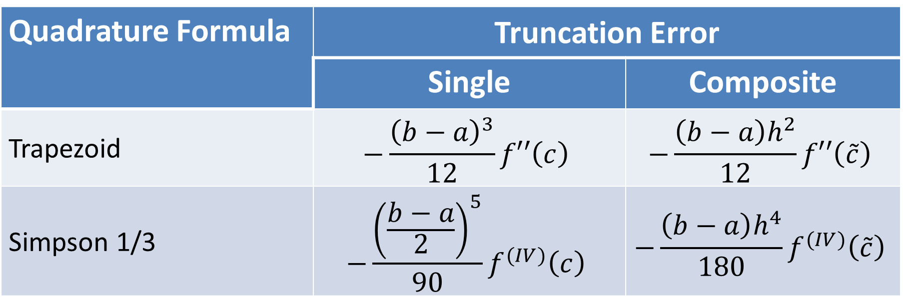
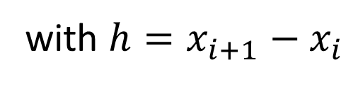
Errors of Quadrature Formulas
Quadrature Formula | Truncation Error
 | Single | Composite
Trapezoid | $$−\frac{{\left(b−a\right)}^{3}}{12}f′′\left(c\right)$$ | $$−\frac{{\left(b−a\right)h}^{2}}{12}f′′\left(\tilde{c}\right)$$
Simpson 1/3 | $$−\frac{{\left(\frac{b−a}{2}\right)}^{5}}{90}f^{(IV)}\left(c\right)$$ | $$−\frac{{\left(b−a\right)h}^{4}}{180}f^{(IV)}\left(\tilde{c}\right)$$
with $h=x_{i+1}−x_{i}$
Notes:
The displayed table summarizes the key data for our two quadrature methods
We discussed already in pervious lectures the error formula in their single version
Based on this knowledge it is possible to estimate as well the truncation error in their composite version
We give these formulas in the last column of the table
Note that, as always, h is the distance between two consecutive interpolation points
Note as well that the composite trapezoid rule has a truncation error proportional to h square.
We say that the order of the error is in order two in h
Similarly, the composite Simpson 1/3 rule has a truncation error proportional to h power 4.
We say that the order of the error is in order four in h

Slide 4










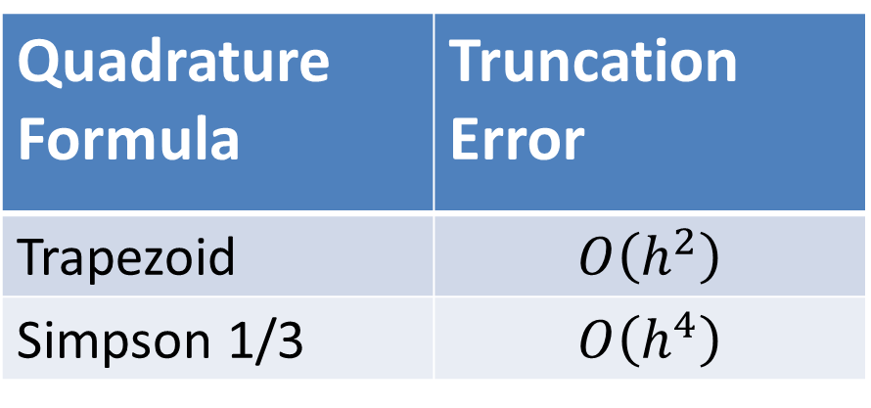



Order of Truncation Error of Composite Methods
$$y$$
$$I_{2}$$
$$y=f(x)$$
$$I_{1}$$
Quadrature Formula | Truncation Error
Trapezoid | $$O\left(h^{2}\right)$$
Simpson 1/3 | $$O\left(h^{4}\right)$$
$$x_{1}$$
$$x_{2}$$
$$x_{3}$$
$$x$$
$$a$$
$${=x}_{0}$$
$$b$$
$${=x}_{4}$$
$$h$$
Notes:
In fact, the really useful part in the error formulas is the knowledge of the order of the method
The simplified table displayed shows these essential information
In a coming lecture, we will learn how, based on this knowledge, we can develop very powerful error estimation formulas that are simple to use in applications
For the moment let us just focus on understanding this new concept

Slide 5
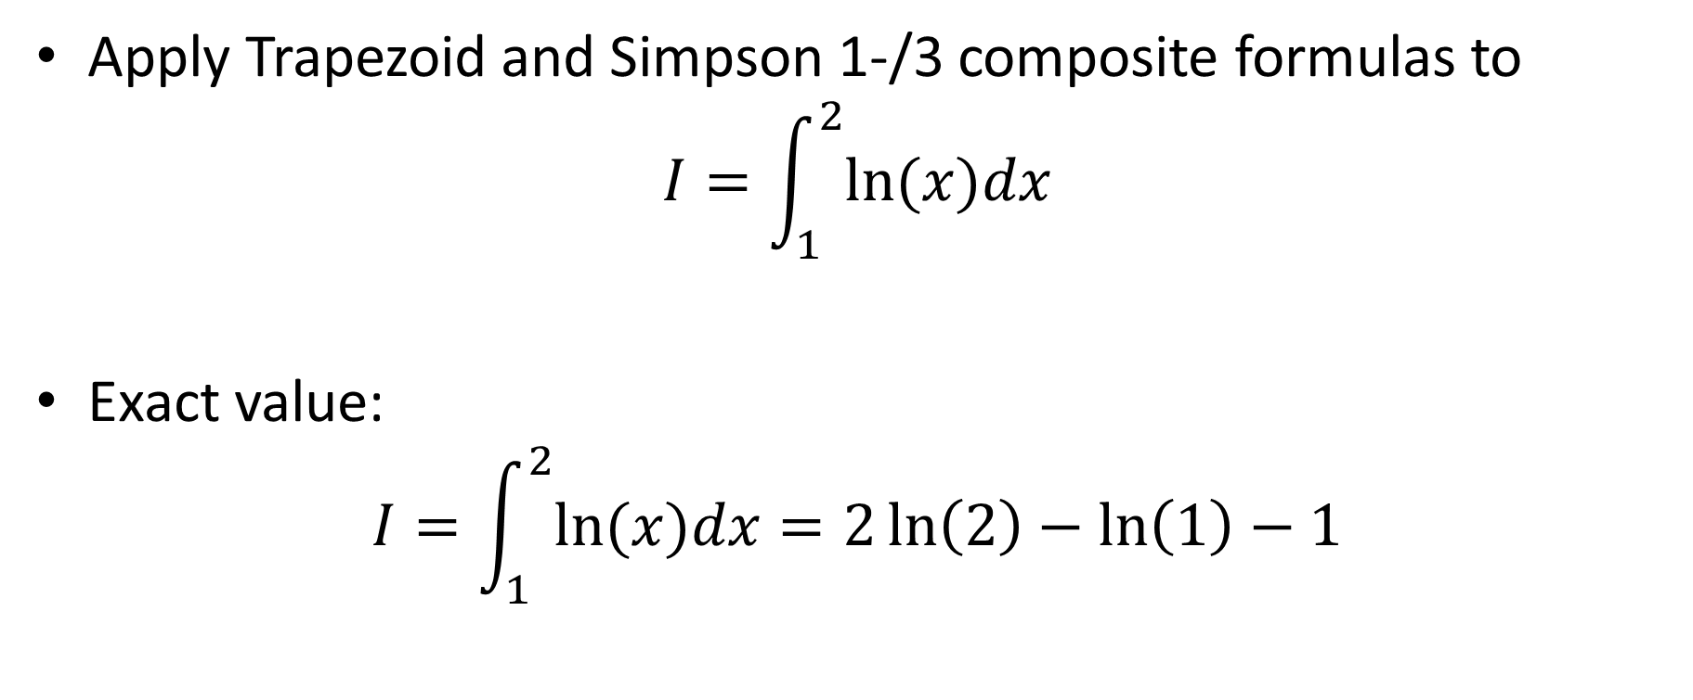
Illustration
Apply Trapezoid and Simpson 1-/3 composite formulas to
$$I=\int_{1}^{2}{ln⁡(x)dx}$$
Exact value:
$$I=\int_{1}^{2}{ln⁡(x)dx}=2\ln\left(2\right)−\ln\left(1\right)−1$$
Notes:
Let us use an example to illustrate these behaviors of the truncation errors
We integrate the natural logarithmic function between 1 and 2
We know the exact value of this defined integral to be 2 ln(2)-ln(1) -1

Slide 6
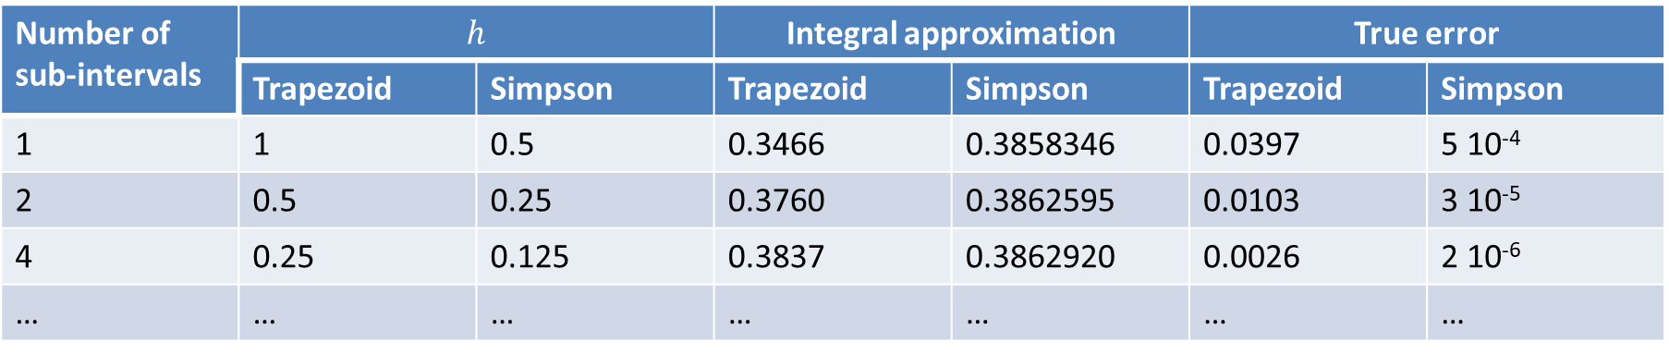
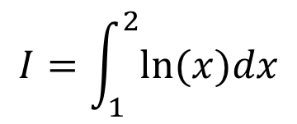
Illustration
$$I=\int_{1}^{2}{ln⁡(x)dx}$$
Number of sub-intervals | $$h$$ |  | Integral approximation |  | True error
 | Trapezoid | Simpson | Trapezoid | Simpson | Trapezoid | Simpson
1 | 1 | 0.5 | 0.3466 | 0.3858346 | 0.0397 | 5 10⁻⁴
2 | 0.5 | 0.25 | 0.3760 | 0.3862595 | 0.0103 | 3 10⁻⁵
4 | 0.25 | 0.125 | 0.3837 | 0.3862920 | 0.0026 | 2 10⁻⁶
… | … | … | … | … | … | …
Notes:
Let us now build a table
We will estimate our defined integral with the composite trapezoid and Simpson 1/3 rules
We use composite methods
In each line of the table we will use a different number of sub-intervals
The first line we just use a single interval.
This is the same as using the single version of the quadrature formulas
In the second line we use 2 sub-intervals
In the next line we use 4 sub-intervals and so on
Each time we compute the estimation of the defined integral using the composite methods
As we know the exact value of this integral we can as well compute the true errors and add them into the table
For each method we calculate as well the distance between two interpolating points
In the lecture on composite methods we have learned how to do this
In the case of the trapezoid method this is the length of the integration interval divided by the number of sub-intervals
In the case of the Simpson 1/3 method this is the length of the integration interval divided by twice the number of sub-intervals
I invite you to try to build this table using the octave scripts you developed in the frame of the lecture on composite methods

Slide 7


Illustration
$$E=0.04h^{1.9952}$$
$$E=0.008h^{3.9701}$$
Notes:
Let us compute the true errors of the Trapezoid and the Simpson 1/3 rule for increasing number of sub-intervals, which results in smaller and smaller values of h
First we note that, as expected, the composite Simpson 1/3 rule, for a given value of h, has a smaller error than the composite trapezoid method
Both methods reduce their error as we use smaller values of h
How fast do they reduce their error?
According what we explained few slides ago, the composite trapezoid method decreases the error proportional to h square
The composite Simpson 1/3 method decrease the error proportional to h power 4
Fitting a power law confirms this behavior
The composite trapezoid method decrease the error proportional to h power 1.9952, which very close to two
And the composite Simpson 1/3 method decrease the error proportional to h power 3.9701 which is very close to four

Slide 8
Illustration
Error no longer drops
Notes:
Can we reduce the error as much as we want?
If we continue our calculations with even smaller values of h we observe that eventually the error, in case of the Simpson 1/3 rule, does no longer decrease but on the contrary will increase

Slide 9
Illustration
Truncation errors
Round-off errors
Notes:
The reason for this are round-off errors
Indeed, the methods will first decrease the total error according what we expect from the truncation error.
But eventually round-off errors take over and the total error increases
This is exactly the same behavior we observed in case of the total error of formulas to estimate the derivative of a function

Slide 10
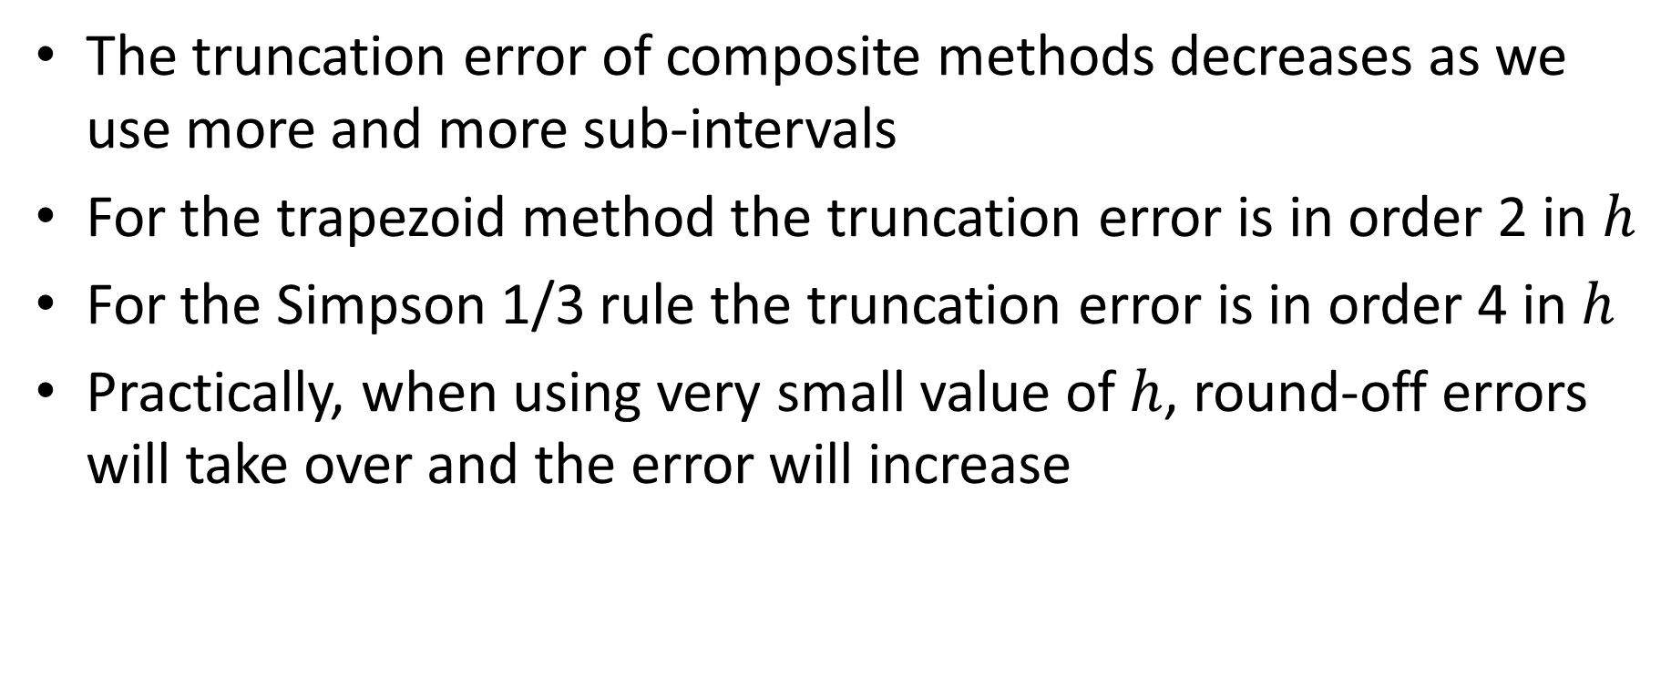
Summary
The truncation error of composite methods decreases as we use more and more sub-intervals
For the trapezoid method the truncation error is in order 2 in $h$
For the Simpson 1/3 rule the truncation error is in order 4 in $h$
Practically, when using very small value of $h$, round-off errors will take over and the error will increase
Notes:
Let us summarize the key findings
The truncation error of composite methods decreases as we use more and more sub-intervals
For the trapezoid method the truncation error is in order 2 in $h$
For the Simpson 1/3 rule the truncation error is in order 4 in $h$
Practically, when using very small value of $h$, round-off errors will take over and the error will increase

